Slide 1
Classification Accuracy and Confusion Matrix
Dr. Qasem Al-Radaideh
Yarmouk University

Slide 2
Accuracy and Error Measures

Slide 3
6.12 Accuracy and Error Measures
The accuracy of a classifier on a given test set is the percentage of test set tuples that are correctly classified by the classifier.
In the pattern recognition literature, this is also referred to as the overall recognition rate of the classifier, that is, it reflects how well the classifier recognizes tuples of the various classes.
We can also speak of the error rate or misclassification rate of a classifier, M, which is simply 1-Acc(M), where Acc(M) is the accuracy of M.
If we were to use the training set to estimate the error rate of a model, this quantity is known as the resubstitution error.
This error estimate is optimistic of the true error rate (and similarly, the corresponding accuracy estimate is optimistic) because the model is not tested on any samples that it has not already seen.

Slide 4
Confusion matrix
The confusion matrix is a useful tool for analyzing how well your classifier can recognize tuples of different classes. A confusion matrix contains information about actual and predicted classifications done by a classification system.
Given m classes, a confusion matrix is a table of at least size m by m. An entry, CM_{i,j} in the first m rows and m columns indicates the number of tuples of class i that were labeled by the classifier as class j.
For a classifier to have good accuracy, ideally most of the tuples would be represented along the diagonal of the confusion matrix, from entry CM_{1,1} to entry CM_{mj,m} with the rest of the entries being close to zero.
Accuracy of a classifier M, acc(M): percentage of test set tuples that are correctly classified by the model M
Error rate (misclassification rate) of M = 1 – acc(M)
Alternative accuracy measures (e.g., for cancer diagnosis)

Slide 5
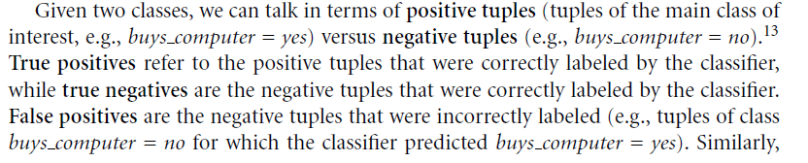

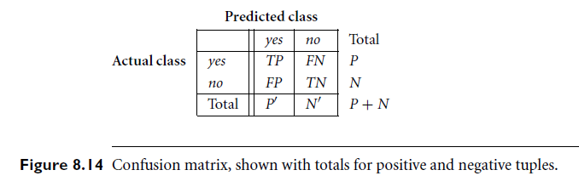
Confusion matrix

Slide 6
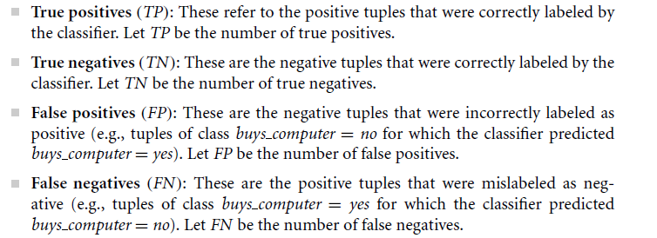

Confusion matrix

Slide 7
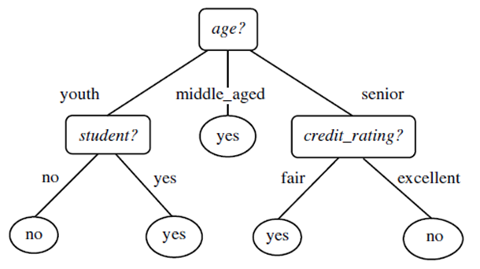
Reminder : Model Evaluation
In Class Exercise:
Given the following Test Dataset, find the classification Accuracy for the Model.
This is the actual class label
No | Age | Income | Student | Credit Rating | Buys computer
1 | Youth | High | No | Fair | No
2 | Senior | Low | Yes | Excellent | Yes
3 | Middle-Age | High | No | Fair | Yes
4 | Youth | Medium | No | Excellent | No
5 | Senior | Low | Yes | Fair | Yes
Classifier Output
No | ✓
No | X
Yes | ✓
No | ✓
Yes | ✓
Estimated Accuracy = 4/5
= 80%

Slide 8
Putting the Classifier output in the Confusion Matrix
A confusion matrix contains information about actual and predicted
classifications done by a classification system.
 |  | Predicted Class
 | classes | buy_computer = yes | buy_computer = no | Accuracy (%)
Actual Classes | buy_computer = Yes | 2 | 1 | 67.0
 | buy_computer = No | 0 | 2 | 100
 | Accuracy | 100 | 67.0 | 80.0

Slide 9
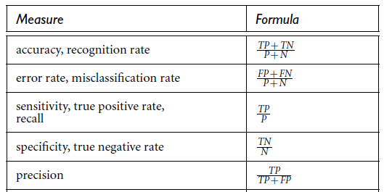
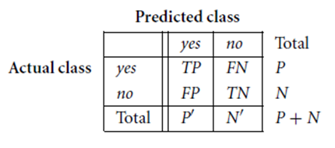
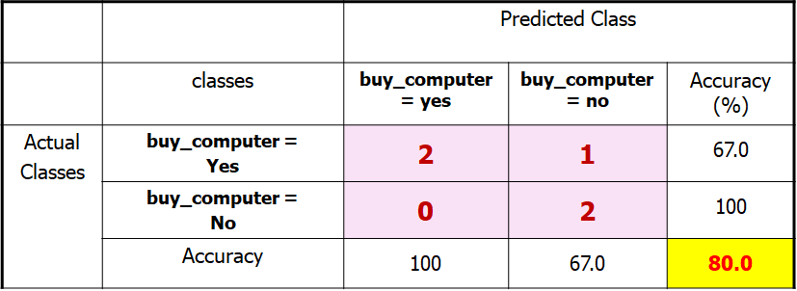
Confusion matrix

Slide 10

Example 2 : How to Interpret the values in the Matrix
classes | buy_computer = yes | buy_computer = no | total | Recognition (%)
buy_computer = yes | 6954 | 46 | 7000 | = 99.34
buy_computer = no | 412 | 2588 | 3000 | = 86.27
total | 7366 | 2634 | 10000 | = 95.52
Recognition (%) | ??? | ???
In Class Discussion.

Slide 11

Example 3: Classifying iris flowers
Sepal length
Sepal width
Petal length
Petal width
Type
1
5.1
3.5
1.4
0.2
Iris setosa
2
4.9
3.0
1.4
0.2
Iris setosa
…
51
7.0
3.2
4.7
1.4
Iris versicolor
52
6.4
3.2
4.5
1.5
Iris versicolor
…
101
6.3
3.3
6.0
2.5
Iris virginica
102
5.8
2.7
5.1
1.9
Iris virginica
…
If petal length < 2.45 then Iris setosa
If sepal width < 2.10 then Iris versicolor
...

Slide 12
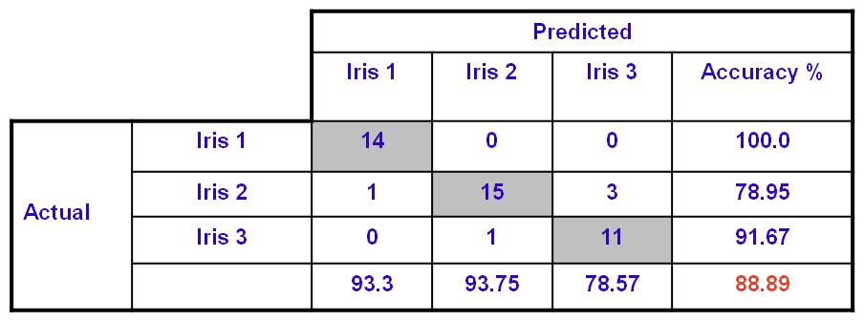
Example 2: How to Interpret the values in the Matrix
The Confusion Matrix result from a classification session for the Iris Dataset using WEKA tool.
- Data Set : 150 Objects
- Training Dataset : 105 objects (70%)
Testing Dataset : 45 objects (30%)
Classes : 3 ( Iris 1 (setosa) , Iris 2 (versoclolor), Iris 3 (verginica))
Table : Confusion Matrix for Iris Dataset
Accuracy of Classification using the test data set

Slide 13
Limitation of Accuracy
Consider a 2-class problem
Number of Class 0 examples = 9990
Number of Class 1 examples = 10
If model predicts everything to be class 0, accuracy is 9990/10000 = 99.9 %
Accuracy is misleading because model does not detect any class 1 example
Note: That’s why we need to look at all measures that can be obtained from the Confusion Matrix.

Slide 14
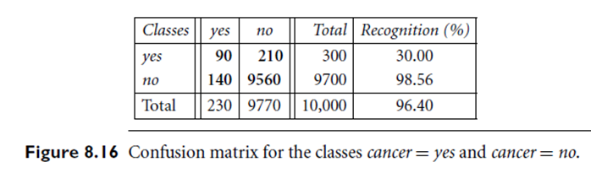
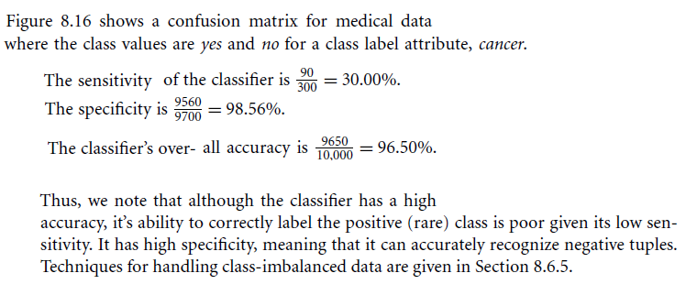
Example 2: Sensitivity and specificity in Medical Domain

Slide 15

End … Thanks
Dr. Qasem Al-Radaideh
Yarmouk University

